Slide 1

CSE 330 – CLOUD COMPUTING (AWS) PROJECT PRESENTATION TEAM MEMBERS ASWIN G E0119062 LOHIT ARUN S E0119042 PRAGADEESHWAR N E0119003

Slide 2
AIRLINES WEBSITE SERVER MANAGEMENT SYSTEM

Slide 3
ABSTRACT
High Availability infrastructure - describes systems that are dependable enough to operate continuously without failing.
They are well-tested and sometimes equipped with redundant components.
High availability refers to those systems that offer a high level of operational performance and quality over a relevant time period.

Slide 4
SERVICES
ELASTIC COMPUTE CLOUD (EC2) - It is designed to make web-scale cloud computing easier for developers.
AMAZON SIMPLE STORAGE SERVICE (S3) – It is an object storage service that offers industry-leading scalability, data availability, security, and performance. This means customers of all sizes and industries can use it to store and protect any amount of data for a range of use cases, such as data lakes, websites etc..

Slide 5
SERVICES
ELASTIC LOAD BALANCER – It automatically distributes incoming application traffic across multiple targets, such as Amazon EC2 instances, containers, IP addresses, Lambda functions, and virtual appliances. It can handle the varying load of your application traffic in a single Availability Zone or across multiple Availability Zones.
AMAZON SIMPLE NOTIFICATION SERVICE (SNS) – It is a fully managed messaging service for both application-to-application (A2A) and application-to-person (A2P) communication.

Slide 6
SERVICES
AMAZON AUTO SCALING – It monitors the applications and automatically adjusts capacity to maintain steady, predictable performance at the lowest possible cost.
AMAZON CLOUDWATCH – It collects monitoring and operational data in the form of logs, metrics, and events, providing you with a unified view of AWS resources, applications, and services that run on AWS and on-premises servers.

Slide 7
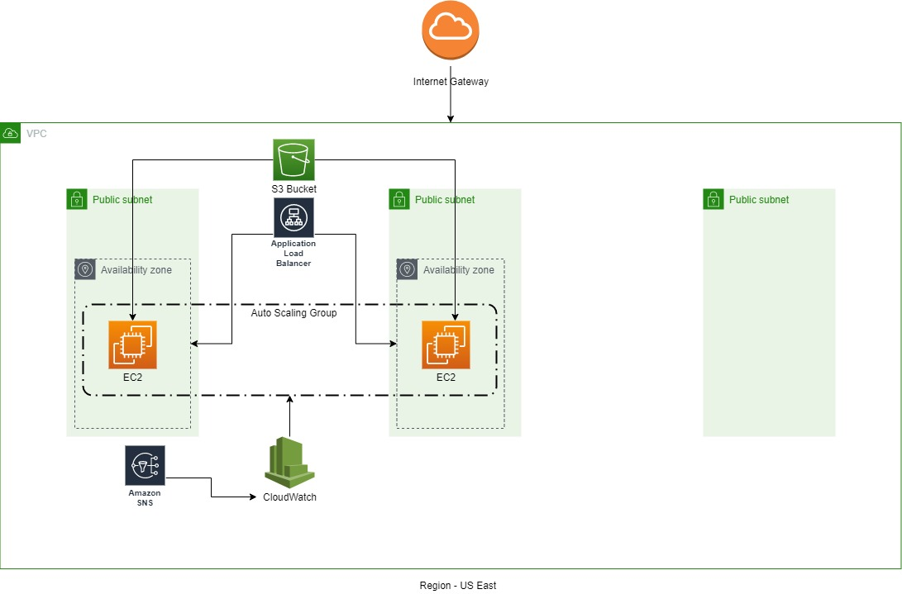
ARCHITECTURE

Slide 8
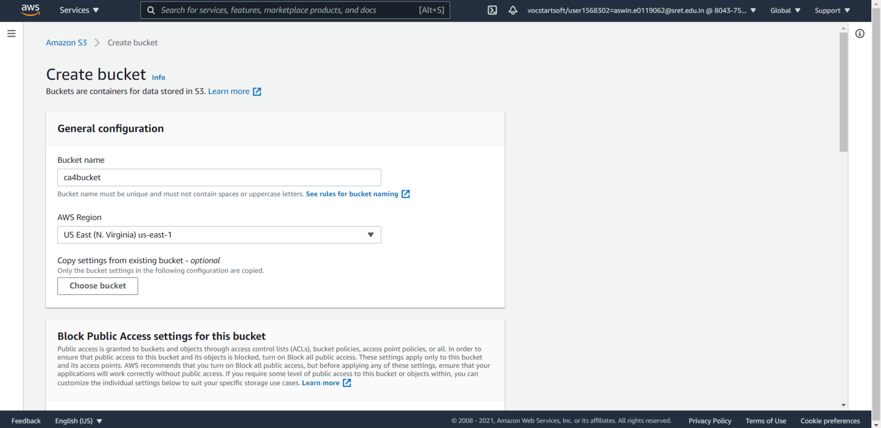
IMPLEMENTATION

Slide 9

IMPLEMENTATION

Slide 10
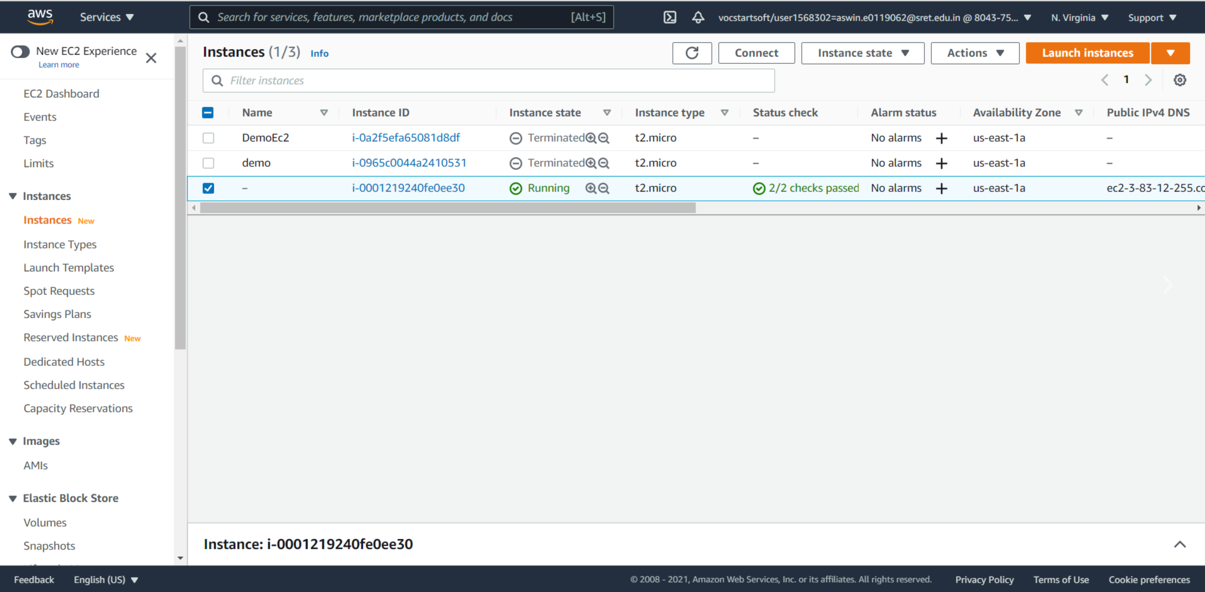
IMPLEMENTATION

Slide 11
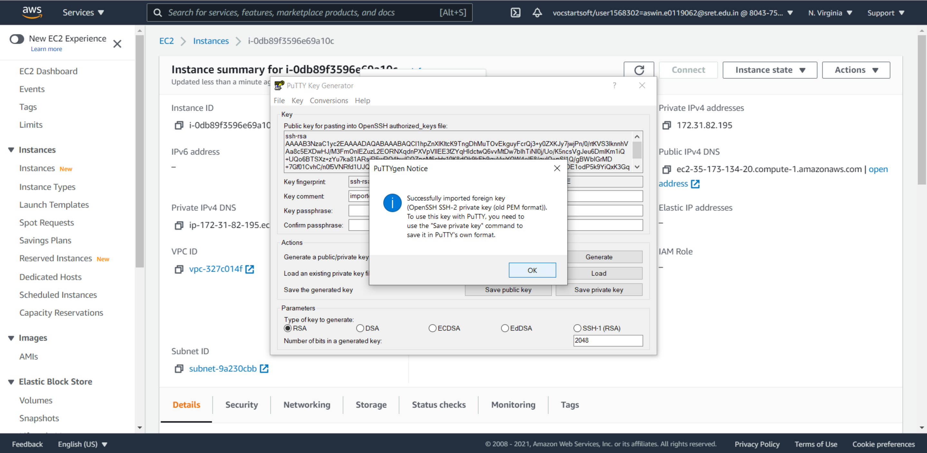
IMPLEMENTATION

Slide 12
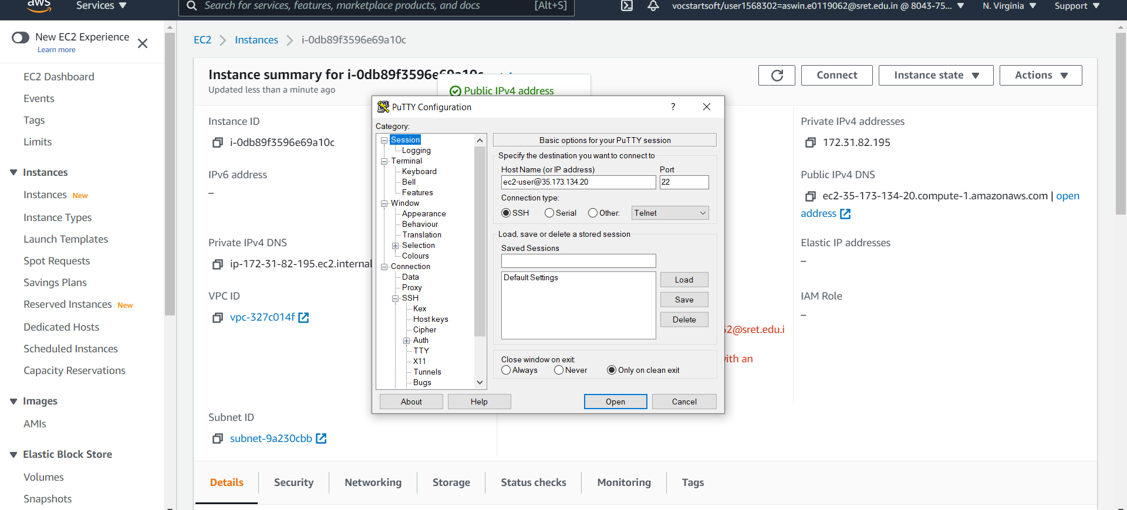
IMPLEMENTATION

Slide 13
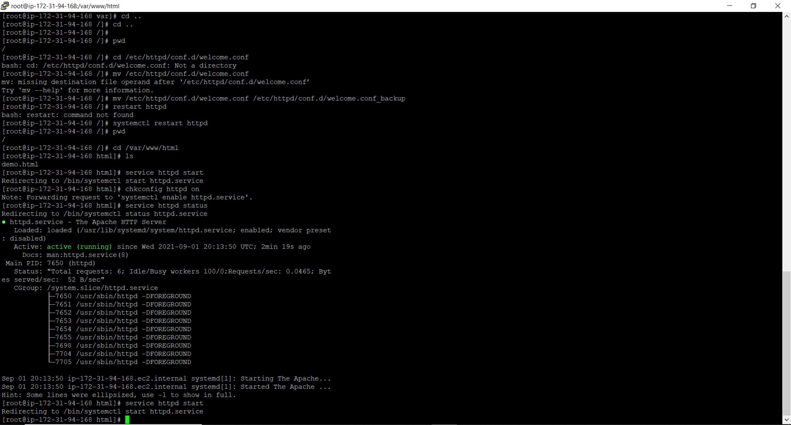
IMPLEMENTATION

Slide 14
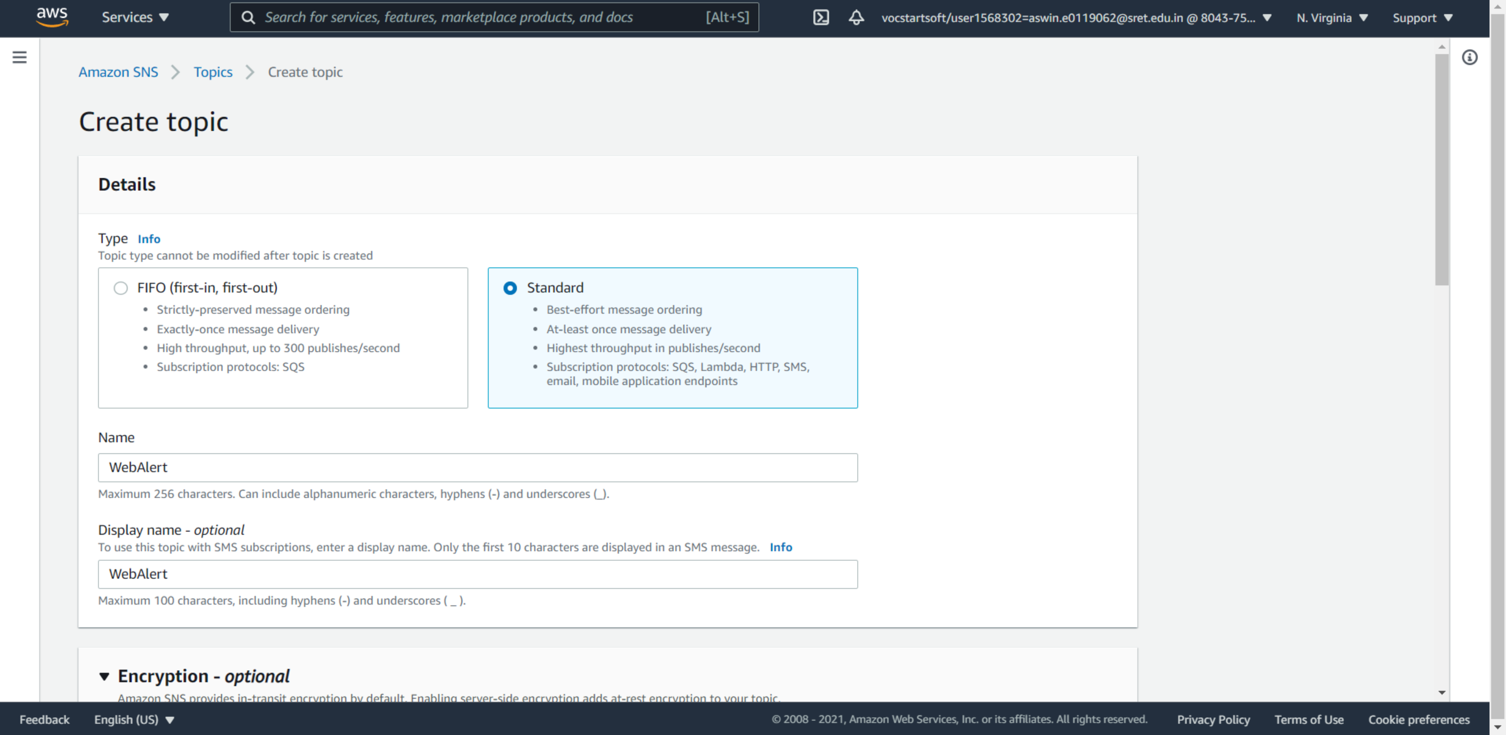
IMPLEMENTATION

Slide 15
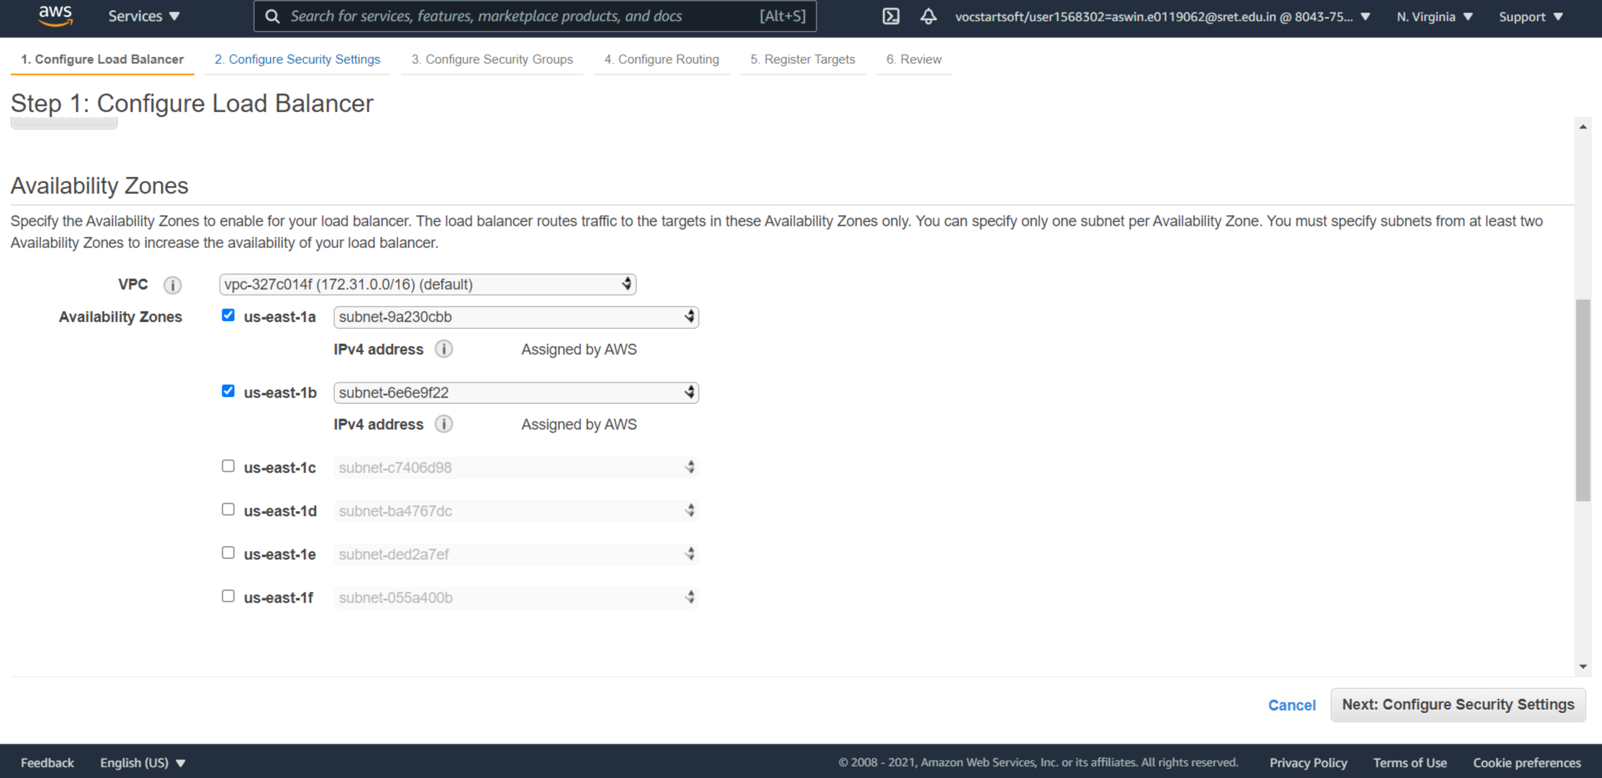
IMPLEMENTATION

Slide 16
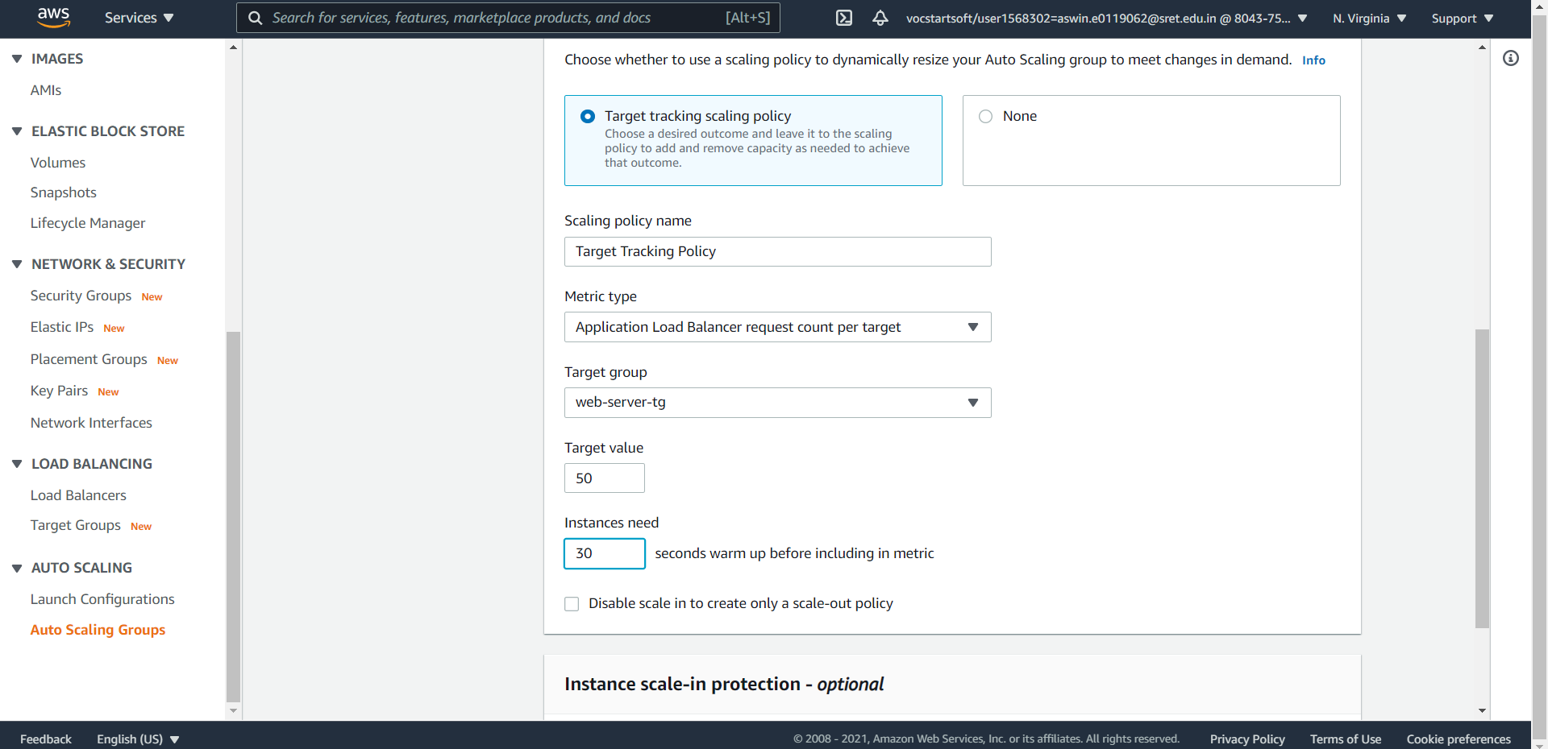
IMPLEMENTATION

Slide 17
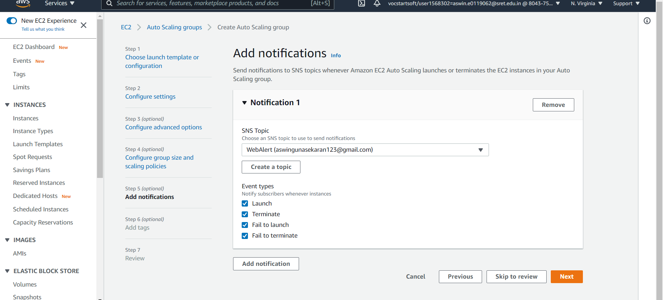
IMPLEMENTATION

Slide 18
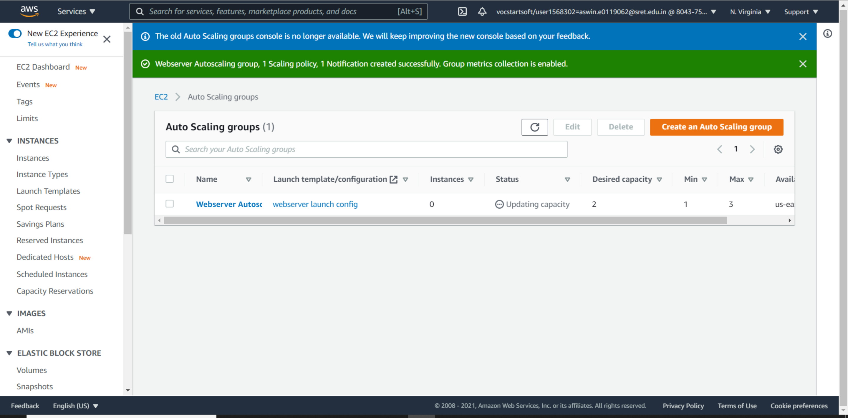
IMPLEMENTATION

Slide 19
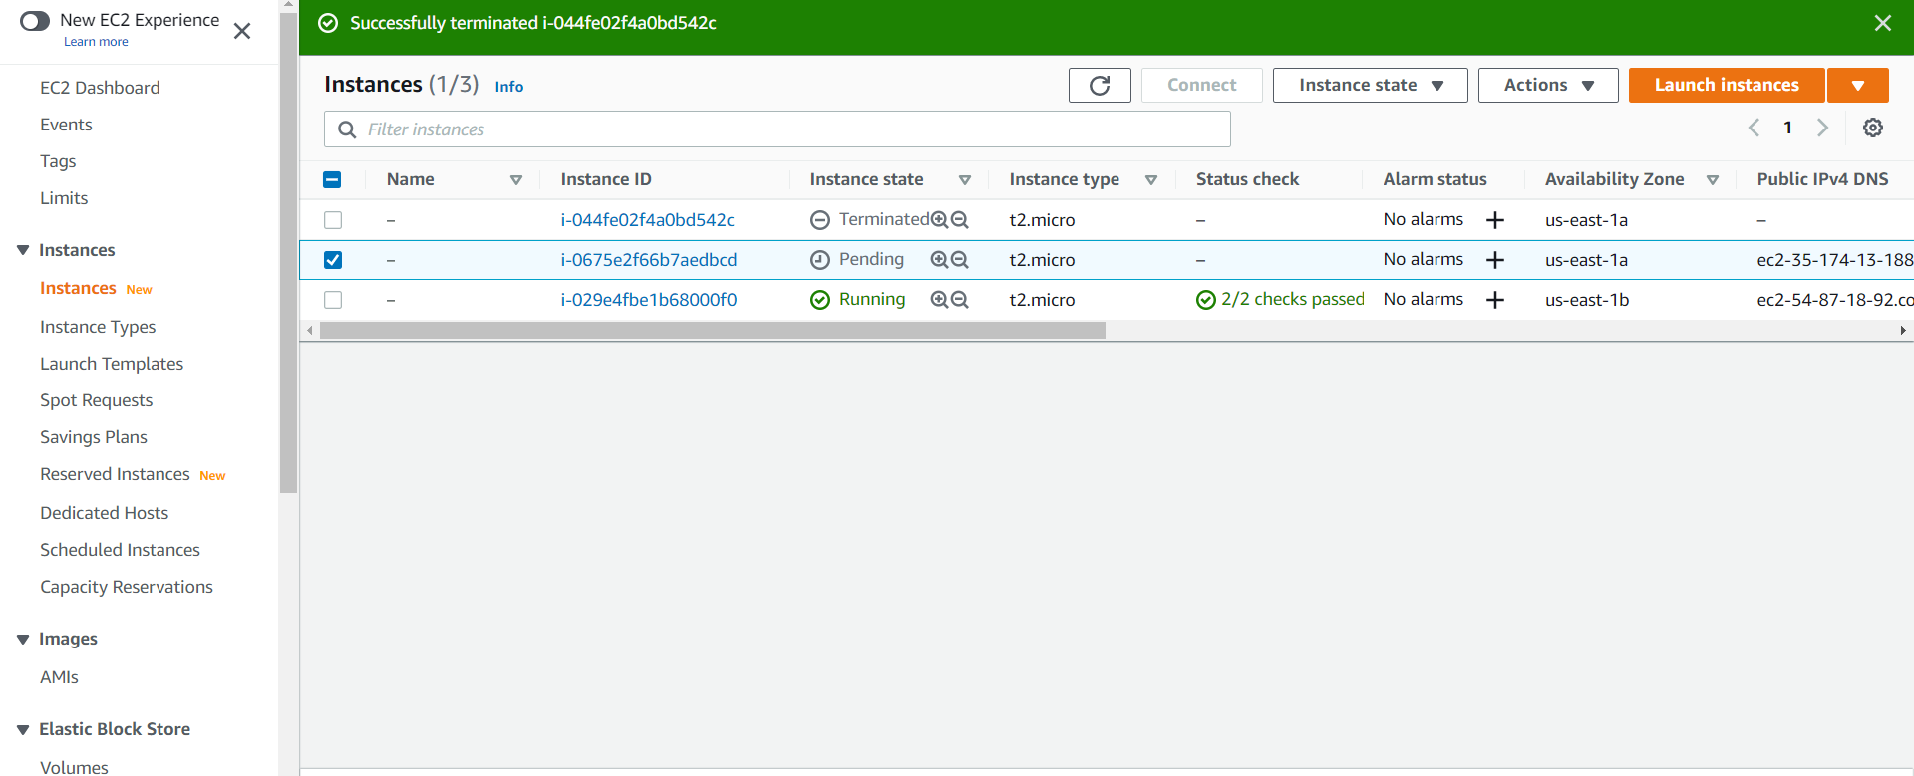
IMPLEMENTATION

Slide 20
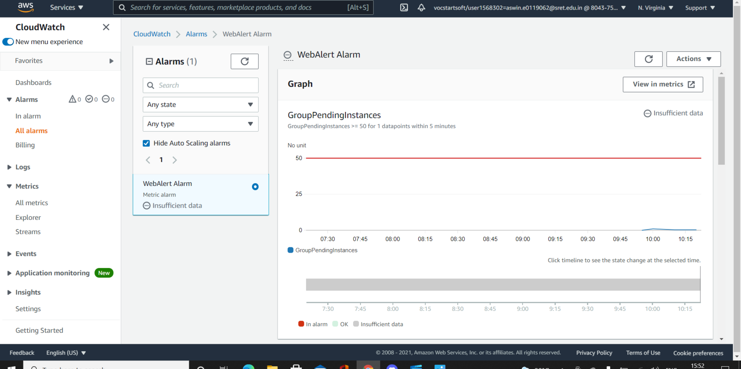
IMPLEMENTATION

Slide 21
Conclusion
So with the use of this infrastructure any company can host their website with no downtime and can receive alerts if there is any obstruction in the server.

